Slide 1

May Showcase
AI Forward Award Winners
6 Innovators. 5 Minutes Each.
30 Minutes of Collective Impact
forumFollowed by Audience Q&A

Slide 2



AI Forward Winner:
Martin Mena
Marketing Configuration Specialist
[ Presenter Headshot ]
Project: Trend Tree System

Slide 3

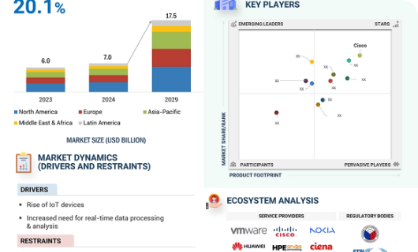
The Friction: Human Dispatch Limitations
Manual Chasing: Standard trend analytics tools demand human operators to manually frame queries.
Noise Overload: Sifting through cross-platform noise (TikTok, Bluesky, Amazon) is unsustainable at scale.
Agency Inefficiencies: External cultural trend trackers run corporate research fees into six figures.

Slide 4






The Solution: Chained Multi-Agent Architecture
Layer 1 & 2: Ingestion
Layer 3: Cross-Model Enrichment
Layer 4: Auto-Pruning
Autonomous listeners actively tap viral APIs 24/7 without needing human direction.
Maintains system health by continuously archiving dead cultural elements overnight.
Passes findings across Gemini, GPT-4, and Claude to confirm trends in under 15 minutes.

Slide 5

Mena Impact: Ultra-Low-Cost Intelligence
Scale Capacity: Currently actively monitoring 136 real-time macro consumer paths.
$0.45
Complete Auditability: Append-only logs track precisely how every AI layer made decisions.
Operational Cost Per Verified Trend
The Vision: Transitioning this setup to act as a core engine for broader strategic planning.

